Slide 1
Using R to Promote Data Interoperability in the Atmospheric Science Community
Josh Roberti, Robert Lee
Cody Flagg, Lee Stanish
10 January 2017
Austin, TX
Annual AMS Conference

Slide 2
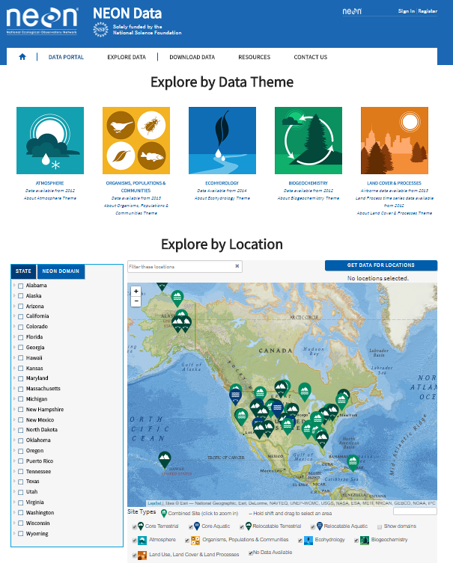
“NEON?... I’ve never heard of it”
Continental-scale ecological Observatory
Open-access data, resources and infrastructure
Standardized measurements
Enable understanding of the effects of climate change, land use change, and invasive species on ecology
30-year time Observatory
2012 - 2017 (Construction Phase)
Building towers
Installing sensors
Algorithm Development
Data QC development
Data Commissioning
2018 onwards (Operational Phase)

Slide 3
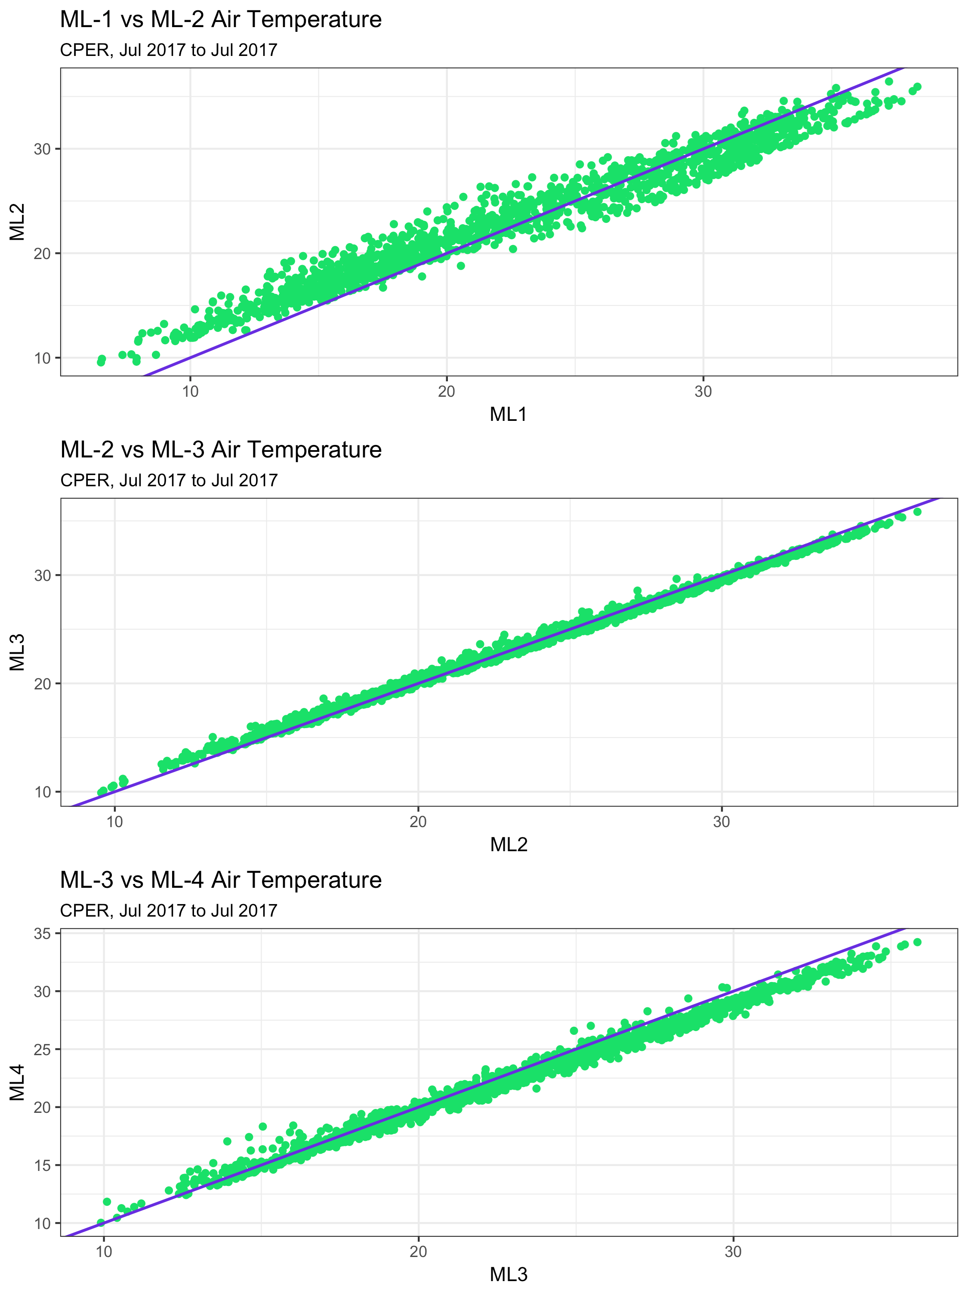
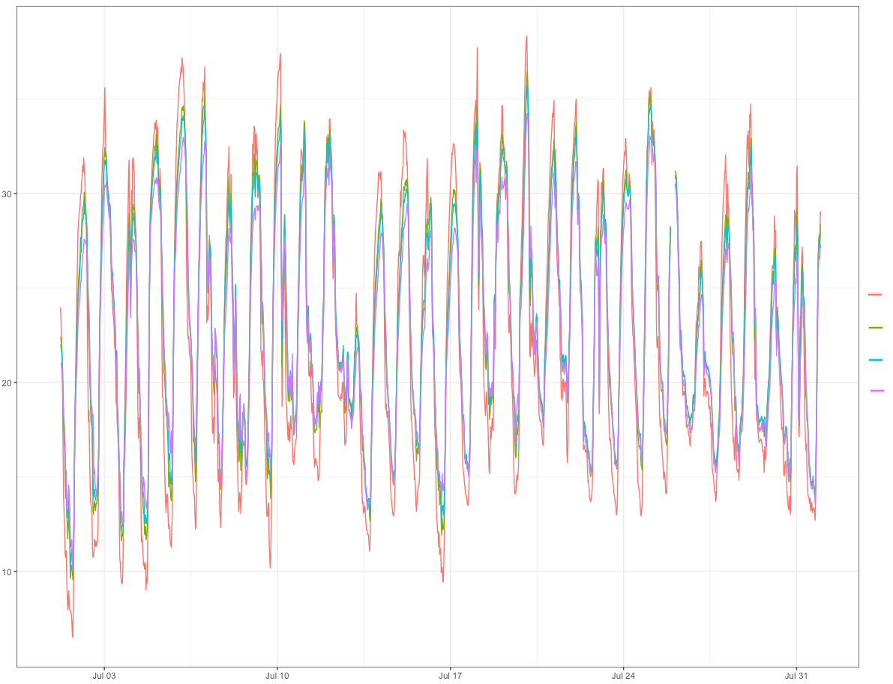
NEON data commissioning
Instrumented Systems (IS) Commissioning examines NEON data health by:
Verifying data quantity (> 95% availability)
Verifying data validity with internal quality reporting (> 90% pass QC tests)
Examining the health of data loggers
Examining correlations of data at different measurement heights
NEON-CPER
℃
ML 1
ML 2
ML 3
ML 4
Date

Slide 4
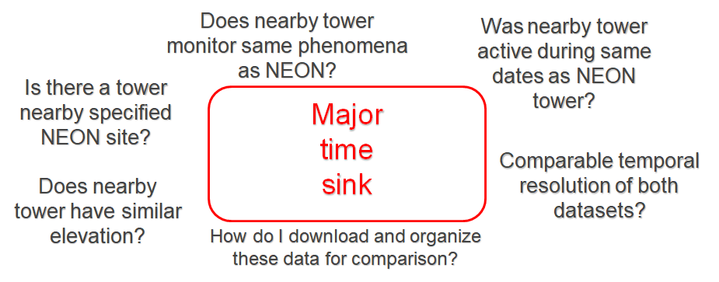
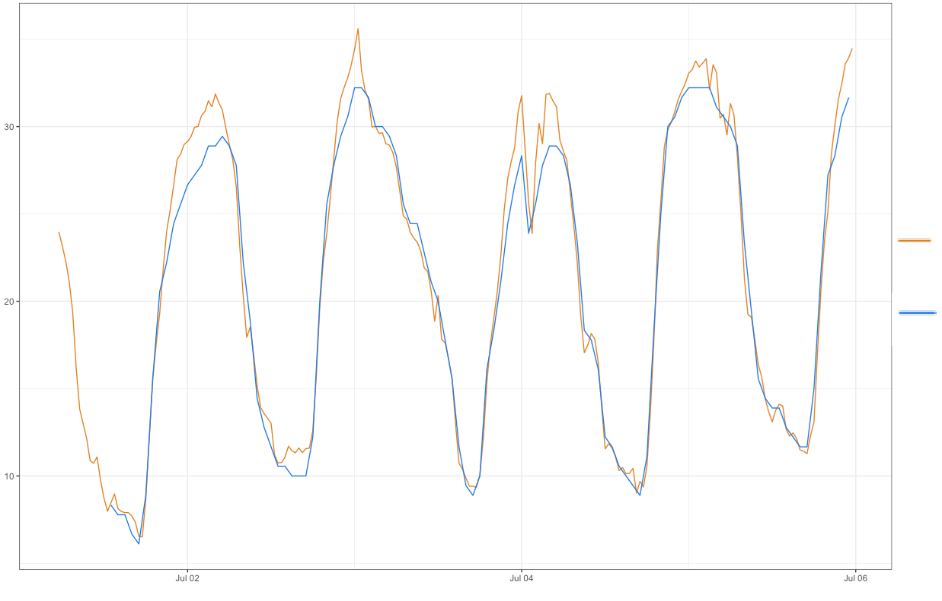
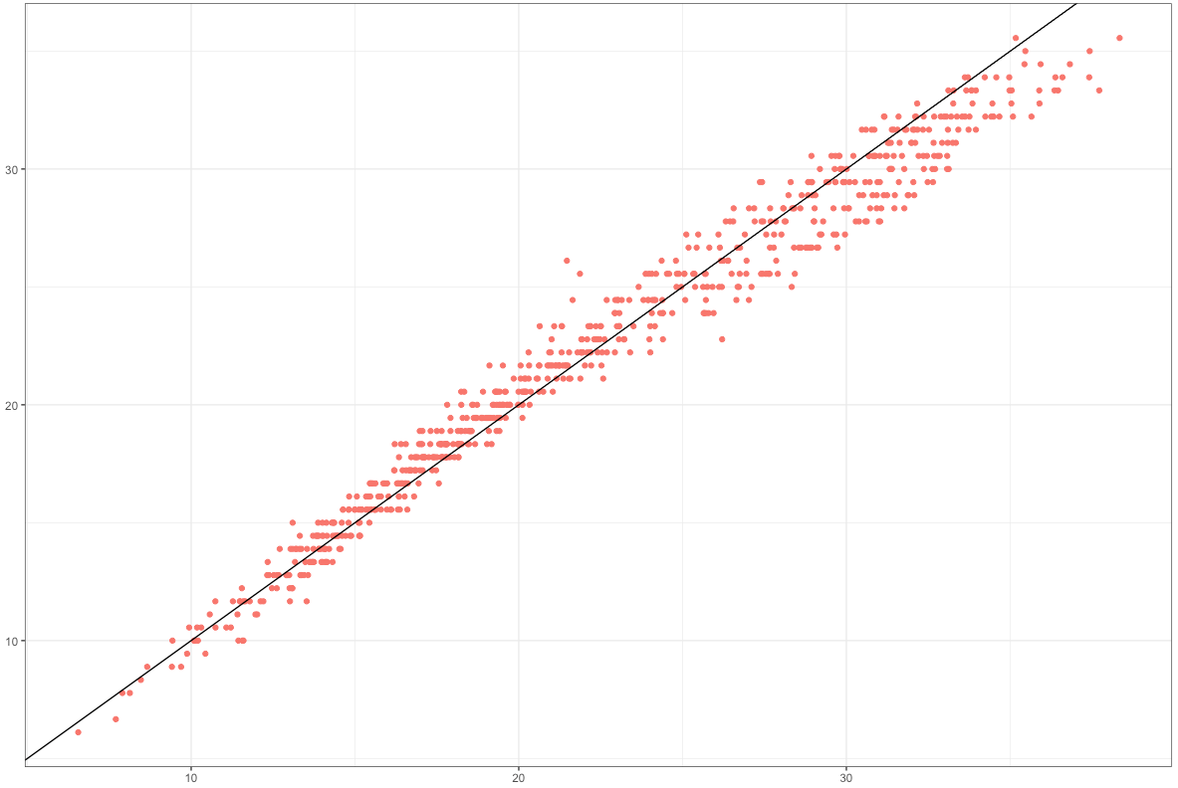
NEON data commissioning
Examining correlations between NEON data and data from nearby non-NEON sites
℃
NEON-CPER
SCAN-2197
SCAN-2197
Date
NEON-CPER

Slide 5
The Bigger Picture
I need [environmental phenomena] data from [spatial region of interest]
observed between [start date] to [end date].
Need accurate station metadata!!

Slide 6
The Bigger Picture
I need [environmental phenomena] data from [spatial region of interest]
observed between [start date] to [end date].
Need accurate station metadata!!
Site Name(s)
Site IDs (e.g., NCDC, WBAN, GHCND)
Platform(s) (e.g., COOP, AWOS, NEON)
Geolocation data
Latitude
Longitude
Elevation
Absolute dates (site)
Variables measured (e.g., air temp, precipitation, etc.)
Sensor information (type of equipment used, e.g. tipping bucket, SRG, etc.)
active dates for each measured phenomenon
Temporal Resolution of data product(s)

Slide 7
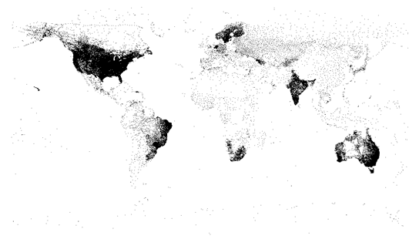
metScanR
What is it?
A tool (database + R package) for locating, mapping, and gathering environmental data and metadata, worldwide.
>107,000 environmental monitoring stations among 219 countries/territories
Plot of Lat. / lon. coordinates of every station in metScanR’s database

Slide 8




metScanR
Metadata ingested from many sources with plans to add many more:

Slide 9
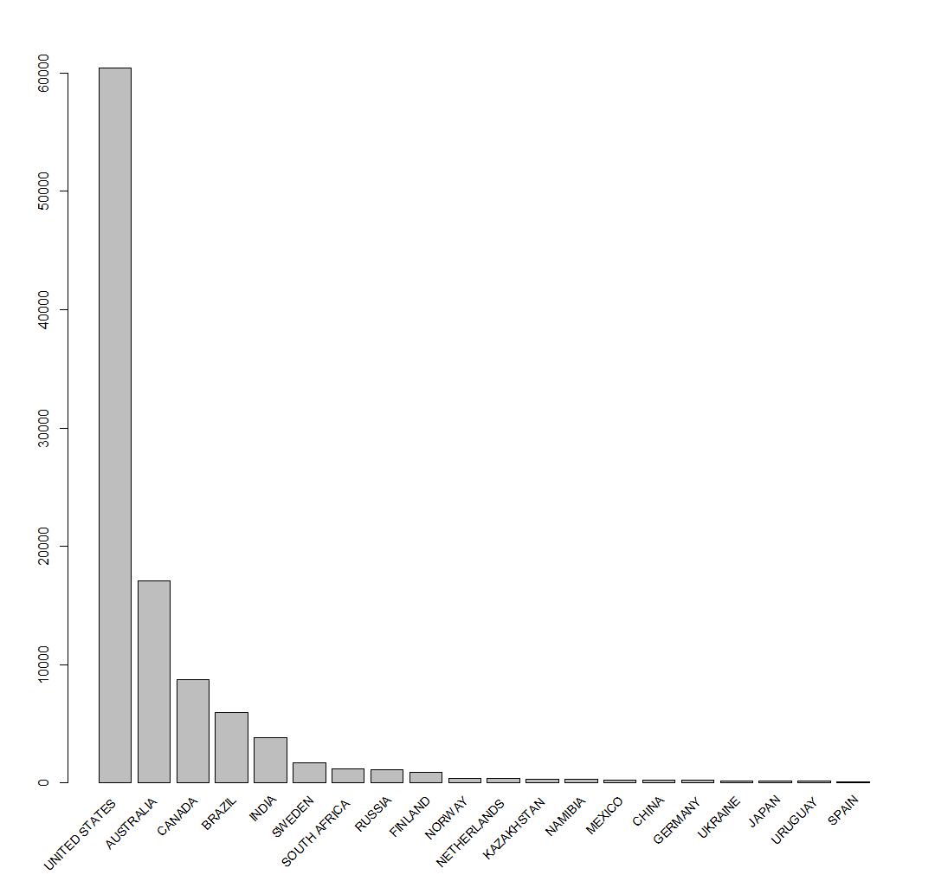
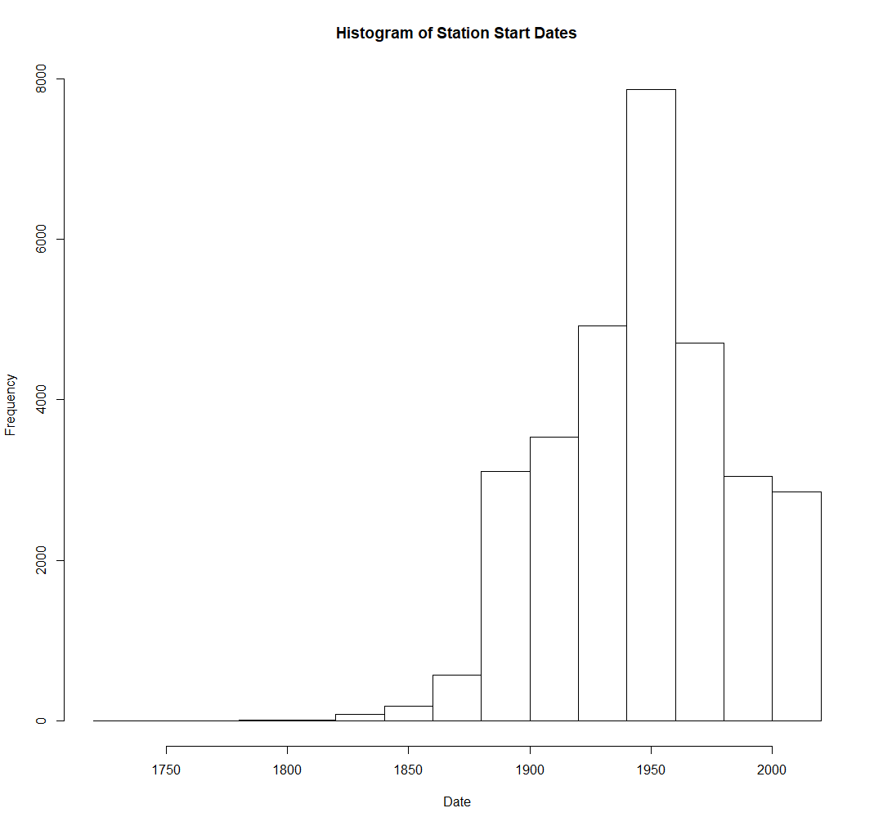
metScanR Database
~31,000
~76,000
219 countries /territories
Oldest record
Downtown Charleston
Charleston, SC
1738!
Notes:
Although Evangelista Torricelli is universally credited with inventing the barometer in 1643, historical documentation also suggests Gasparo Berti, an Italian mathematician and astronomer, unintentionally built a water barometer sometime between 1640 and 1643.
Daniel Gabriel Fahrenheit (1686-1736) was the German physicist who invented the alcohol thermometer in 1709, and the mercury thermometer in 1714.

Slide 10
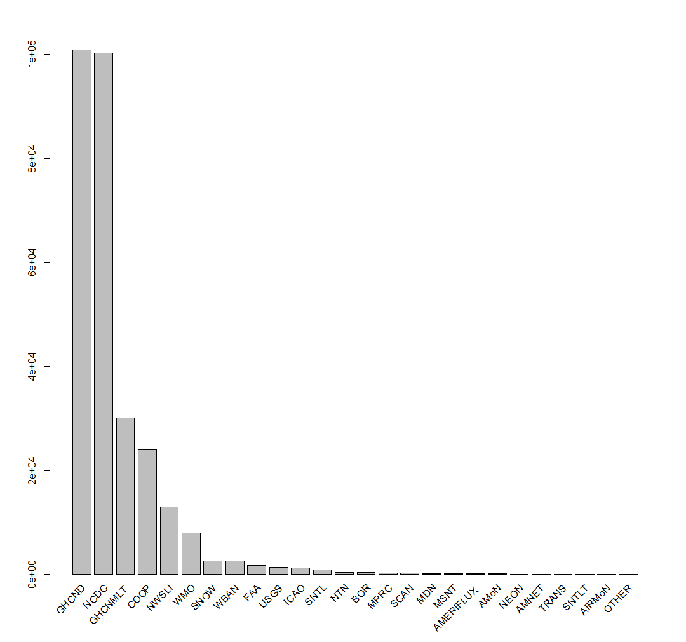
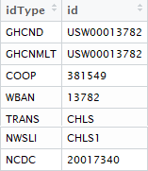
metScanR Database
A single station may be part of many networks, can have many associated identifiers…
Notes:
Although Evangelista Torricelli is universally credited with inventing the barometer in 1643, historical documentation also suggests Gasparo Berti, an Italian mathematician and astronomer, unintentionally built a water barometer sometime between 1640 and 1643.
Daniel Gabriel Fahrenheit (1686-1736) was the German physicist who invented the alcohol thermometer in 1709, and the mercury thermometer in 1714.

Slide 11
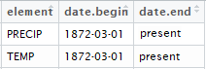
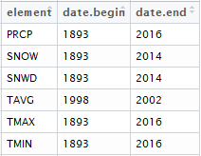
metScanR Database
A single station may be part of many networks, can have many associated identifiers… may have similar data product types stored among many repositories…
Same station & data products; Different repositories
Notes:
Although Evangelista Torricelli is universally credited with inventing the barometer in 1643, historical documentation also suggests Gasparo Berti, an Italian mathematician and astronomer, unintentionally built a water barometer sometime between 1640 and 1643.
Daniel Gabriel Fahrenheit (1686-1736) was the German physicist who invented the alcohol thermometer in 1709, and the mercury thermometer in 1714.

Slide 12
metScanR Database
A single station may be part of many networks, can have many associated identifiers… may have similar data product types stored among many repositories… which are available at different temporal resolutions
Daily and monthly data products
Hourly data products
Same station & data products; Different repositories & time scales
Notes:
Although Evangelista Torricelli is universally credited with inventing the barometer in 1643, historical documentation also suggests Gasparo Berti, an Italian mathematician and astronomer, unintentionally built a water barometer sometime between 1640 and 1643.
Daniel Gabriel Fahrenheit (1686-1736) was the German physicist who invented the alcohol thermometer in 1709, and the mercury thermometer in 1714.

Slide 13
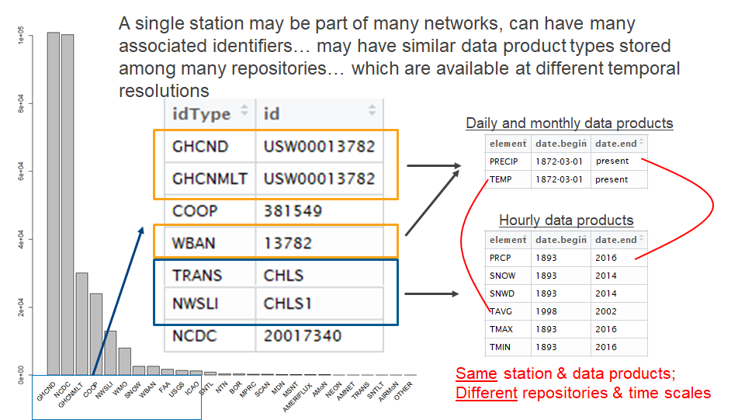
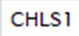
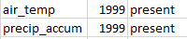
metScanR Database
10-minute data products
Notes:
Although Evangelista Torricelli is universally credited with inventing the barometer in 1643, historical documentation also suggests Gasparo Berti, an Italian mathematician and astronomer, unintentionally built a water barometer sometime between 1640 and 1643.
Daniel Gabriel Fahrenheit (1686-1736) was the German physicist who invented the alcohol thermometer in 1709, and the mercury thermometer in 1714.

Slide 14
metScanR Database
You get the idea..
10-minute data products
Notes:
Although Evangelista Torricelli is universally credited with inventing the barometer in 1643, historical documentation also suggests Gasparo Berti, an Italian mathematician and astronomer, unintentionally built a water barometer sometime between 1640 and 1643.
Daniel Gabriel Fahrenheit (1686-1736) was the German physicist who invented the alcohol thermometer in 1709, and the mercury thermometer in 1714.

Slide 15
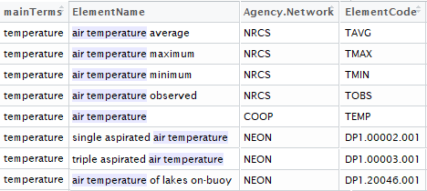
N-gram Search
Implemented a hierarchical n-gram search tool to account for nomenclature discrepancies among all networks.
N-grams:
n-gram | Definition | Example
Uni-gram | One word | Temperature
Bi-gram | Two words | Air Temperature
Tri-gram | Three words | Minimum Air Temperature Maximum Air Temperature Average Air Temperature Mean Air Temperature Air Temperature Mean Air Temperature Maximum Air Temperature Average Air Temperature Minimum …
ElementCode is needed for downloading data via Network APIs

Slide 16
N-gram Search
Implemented a hierarchical n-gram search tool to account for nomenclature discrepancies among all networks.
N-grams:
n-gram | Definition | Example
Uni-gram | One word | Temperature
Bi-gram | Two words | Air Temperature
Tri-gram | Three words | Minimum Air Temperature Maximum Air Temperature Average Air Temperature Mean Air Temperature Air Temperature Mean Air Temperature Maximum Air Temperature Average Air Temperature Minimum …
ElementCode is needed for downloading data via Network APIs
The metScanR database currently comprises 456 n-grams pertaining to environmental data.
abundantly measured phenomena (e.g., air temperature)
sparsely measured phenomena (e.g., soil microbe biomass)

Slide 17
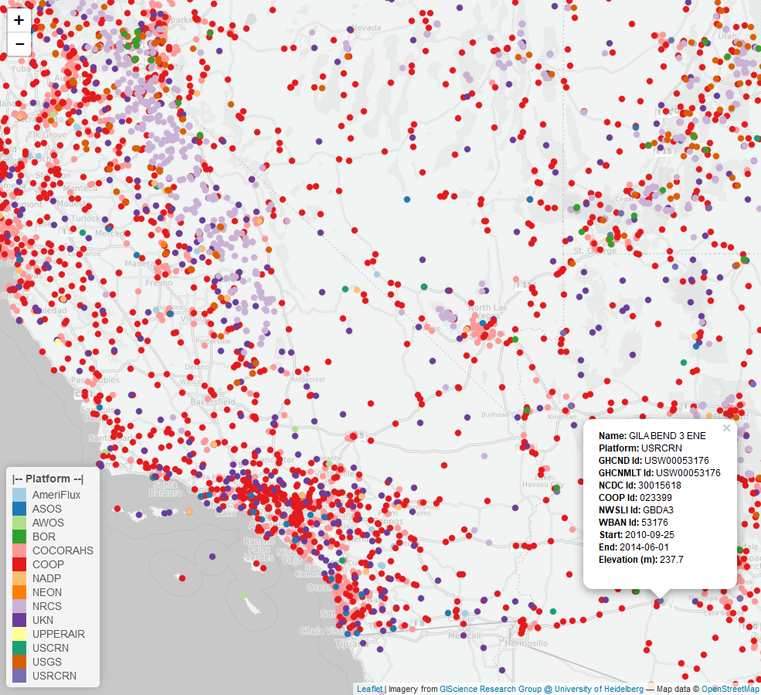
metScanR R package
Inspired by Mesowest.com
Features
Mitigates time sink
Users can search for and filter metadata from via:
Elevation
Location
Lat / Lon
Nearby POI
Active dates
Elements Measured
Country
Platform (network) type
ID type
Station ID
Station IDs Allow data to be downloaded from numerous databases

Slide 18
Who collects the data?
Government funded organizations with different goals and missions…
"provide leadership on food, agriculture, natural resources, rural development, nutrition, and related issues based on sound public policy, the best available science, and efficient management.”
[https://www.lwv.org/a1-united-states-department-agriculture]
“To understand and predict changes in climate, weather, oceans, and coasts, to share that knowledge and information with others, and to conserve and manage coastal and marine ecosystems and resources.”
[http://www.noaa.gov/about-our-agency]
“enable understanding and forecasting of the impacts of climate change, land use change and invasive species on continental-scale ecology – by providing infrastructure and consistent methodologies to support research and education in these areas.”
[http://www.neonscience.org/observatory/about]
“provide the scientific community, policy makers, and society with the knowledge and predictive understanding necessary to conserve, protect, and manage the nation's ecosystems, their biodiversity, and the services they provide.”
[https://lternet.edu/node/20]
Notes:
Put the visio diagram with all the agencies and sub networks etc. Find mission statements of each network / observatory. Show simple depiction of

Slide 19
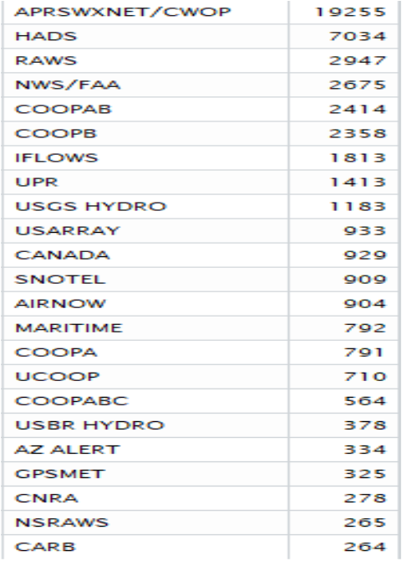
Collecting Environmental Data
Notes:
Put the visio diagram with all the agencies and sub networks etc. Find mission statements of each network / observatory. Show simple depiction of

Slide 20
Collecting Environmental Data
Notes:
Put the visio diagram with all the agencies and sub networks etc. Find mission statements of each network / observatory. Show simple depiction of

Slide 21
Storing Environmental Data
Multiple data repositories managed by different organizations results in discrepancies in:
Nomenclature

Slide 22
Use Cases

Slide 23
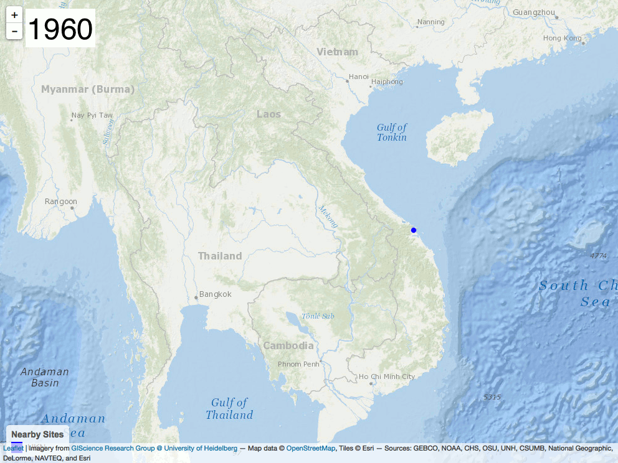
Vietnam War loop

Slide 24
metScanR GUI

Slide 25
Future Goals
Package updates every 3 to 6 months
New functions to filter data by:
US State
Temporal availability of data
Additions of following networks:
LTER
LTAR
ARM
GNIP
[list other networks]
Data downloads and merging (link metScanR to other R packages):
RNRCS – NRCS data
nneo – NEON data
rnoaa – NOAA / HOMR data
“NEON’s open-access data, resources and infrastructure will enable scientists, educators, planners, decision makers and the public to map, understand and predict the effects of human activities on ecology and effectively address critical ecological questions and issues.”

